Slide 1




Machine Learning in Python with scikit-learn
Dr. Randy Olson
rso@randalolson.com
@randal_olson
randalolson.com

Slide 2
Who am I?
AI researcher
B.S. in CS, Uni. Central Florida (2010)
Ph.D. in CS / EEBB, Michigan State Uni. (2015)
Senior Data Scientist, Inst. Biomed. Inf. @ UPenn
Data tinkerer
Data blog: randalolson.com/blog/
Community leader: reddit.com/r/DataIsBeautiful

Slide 3
What you will learn about
What kind of problems you apply machine learning to
Python scientific computing ecosystem
How the data should be shaped for sklearn
The sklearn interface
How to build and use sklearn ML models
Both for supervised and unsupervised ML
Cross-validation and model overfitting/underfitting
Hyperparameter optimization and grid search
Feature preprocessing in sklearn
Putting it all together with sklearn Pipelines
Teaser: Automated machine learning

Slide 4
What you won’t learn about
Advanced math/theory behind ML models
ML models outside of sklearn
XGBoost
Deep learning / Artificial neural networks
…
Advanced hyperparameter optimization
Out-of-core learning
…

Slide 5
Links
Tutorial material on GitHub:
https://github.com/rhiever/webstep-sklearn-quickstart
Contact Info:
Dr. Randy Olson
rso@randalolson.com
http://www.randalolson.com
@randal_olson

Slide 6
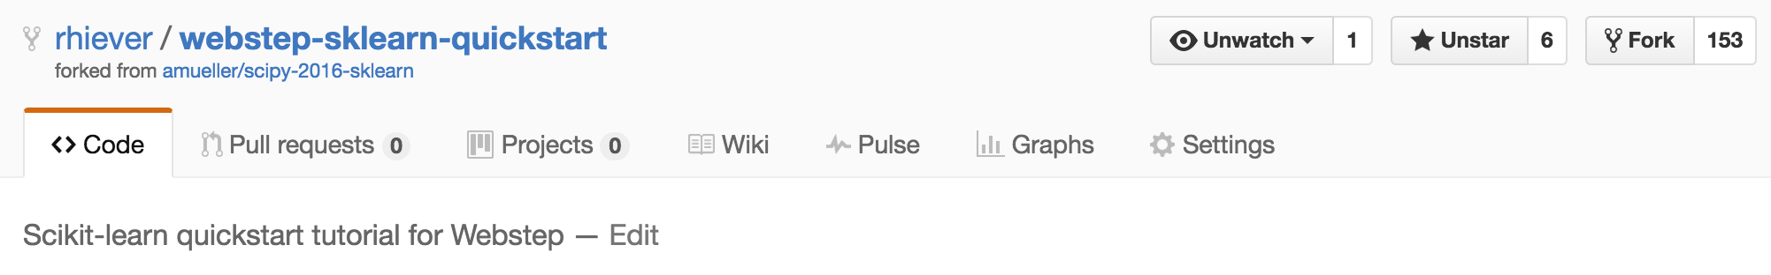
Tutorial Setup I
a) Fork the Repository (if you haven’t done so already):
b) Sync an older fork:
$ git remote add upstream https://github.com/rhiever/webstep-sklearn-quickstart.git
$ git fetch upstream
$ git checkout master merge upstream/master

Slide 7
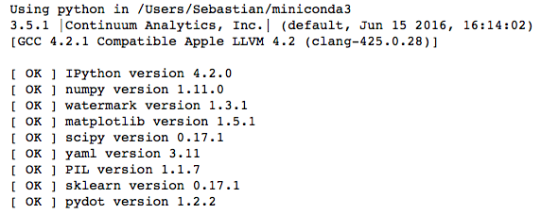
Tutorial Setup II
jupyter notebook check_env.ipynb
python fetch_data.py
~456 MB!!!

Slide 8
Our Agenda
Day 1 Session: Saturday, 9:00 AM - 3:00 PM
Day 2 Session: Sunday, 9:00 AM - 3:00 PM

Slide 9
Day 1 Session
9:00 AM - 3:00 PM
01 Introduction to machine learning with sample applications
02 Scientific Computing Tools for Python: NumPy, SciPy, and matplotlib
03 Data formats, preparation, and representation
04 Supervised learning: Training and test data
05 Supervised learning: Estimators for classification
06 Supervised learning: Estimators for regression analysis
07 Unsupervised learning: Unsupervised Transformers
08 Unsupervised learning: Clustering
09 The scikit-learn estimator interface
10 Preparing a real-world dataset (titanic)
11 Working with text data via the bag-of-words model
12 Application: SMS spam classification

Slide 10
Day 2 Session
9:00 AM - 3:00 PM
13 Cross-Validation
14 Model complexity and grid search for adjusting hyperparameters
15 Scikit-learn Pipelines
16 Supervised learning: Performance metrics for classification
17 Supervised learning: Linear Models
18 Supervised learning: Support Vector Machines
19 Supervised learning: Decision trees and random forests, ensemble methods
20 Supervised learning: feature selection
21 Unsupervised learning: Hierarchical and density-based clustering algorithms
22 Unsupervised learning: Non-linear dimensionality reduction
23 Automated machine learning

Slide 11
Day 1 Session
9:00 AM - 3:00 PM
01 Introduction to machine learning with sample applications
02 Scientific Computing Tools for Python: NumPy, SciPy, and matplotlib
03 Data formats, preparation, and representation
04 Supervised learning: Training and test data
05 Supervised learning: Estimators for classification
06 Supervised learning: Estimators for regression analysis
07 Unsupervised learning: Unsupervised Transformers
08 Unsupervised learning: Clustering
09 The scikit-learn estimator interface
10 Preparing a real-world dataset (titanic)
11 Working with text data via the bag-of-words model
12 Application: SMS spam classification

Slide 12
What is Machine Learning?
Inputs (observations)
“Traditional” programming
Programmer
Program
Computer
Outputs
Machine Learning is the field of study that gives computers the ability to learn without being explicitly programmed.
-- Arthur Samuel (1959)
Inputs (observations)
Machine Learning
Computer
Program
Outputs

Slide 13
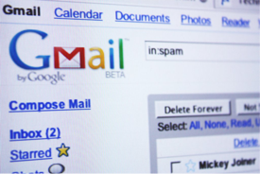
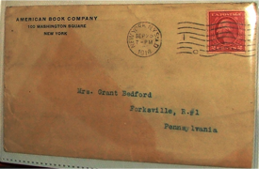

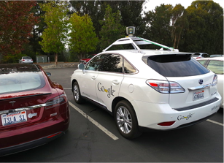
Examples of Machine Learning
https://flic.kr/p/5BLW6G [CC BY 2.0]
http://commons.wikimedia.org/wiki/File:American_book_company_1916._letter_envelope-2.JPG#filelinks [public domain]
http://commons.wikimedia.org/wiki/File:Netflix_logo.svg [public domain]
And many, many more …
By Steve Jurvetson [CC BY 2.0]

Slide 14
Generalization is key!

Slide 15
3 Types of Learning
Supervised
Unsupervised
Reinforcement
Learning from labeled data
e.g., spam classification
Discover structure in unlabeled data
e.g., document clustering
Learning by “doing” with rewards for actions
e.g., Google AlphaGo

Slide 16
Supervised Learning
Supervised
Classification
Regression
y=12.5
?
?
x=0.8

Slide 17
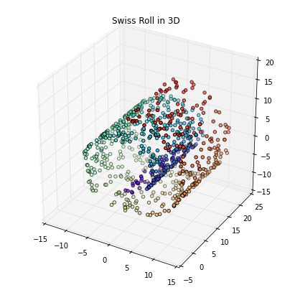
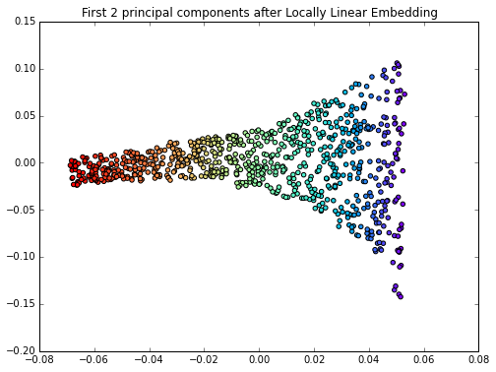
Unsupervised Learning
Unsupervised
Clustering
Compression

Slide 18
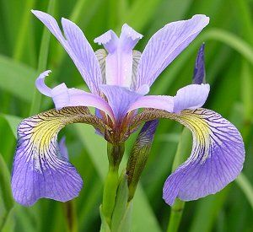
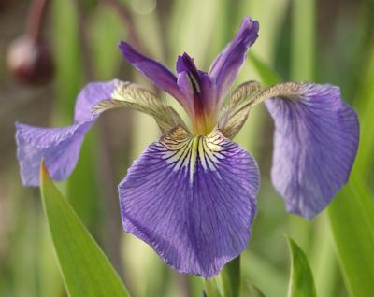
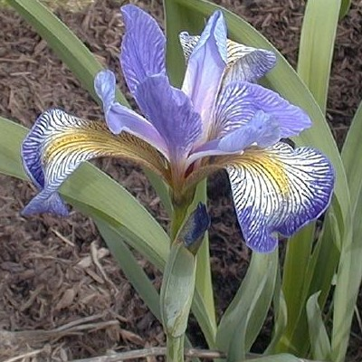
Flower Classification
Iris-Setosa
Iris-Versicolor
Iris-Setosa

Slide 19
Data Representation

Slide 20
Day 1 Session
9:00 AM - 3:00 PM
01 Introduction to machine learning with sample applications
02 Scientific Computing Tools for Python: NumPy, SciPy, and matplotlib
03 Data formats, preparation, and representation
04 Supervised learning: Training and test data
05 Supervised learning: Estimators for classification
06 Supervised learning: Estimators for regression analysis
07 Unsupervised learning: Unsupervised Transformers
08 Unsupervised learning: Clustering
09 The scikit-learn estimator interface
10 Preparing a real-world dataset (titanic)
11 Working with text data via the bag-of-words model
12 Application: SMS spam classification

Slide 21
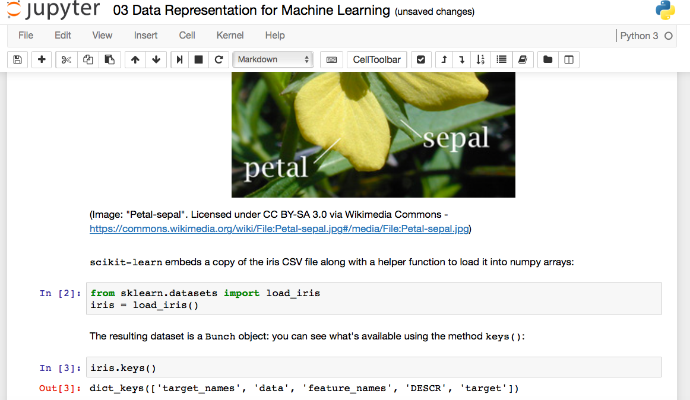
Jupyter Notebooks

Slide 22
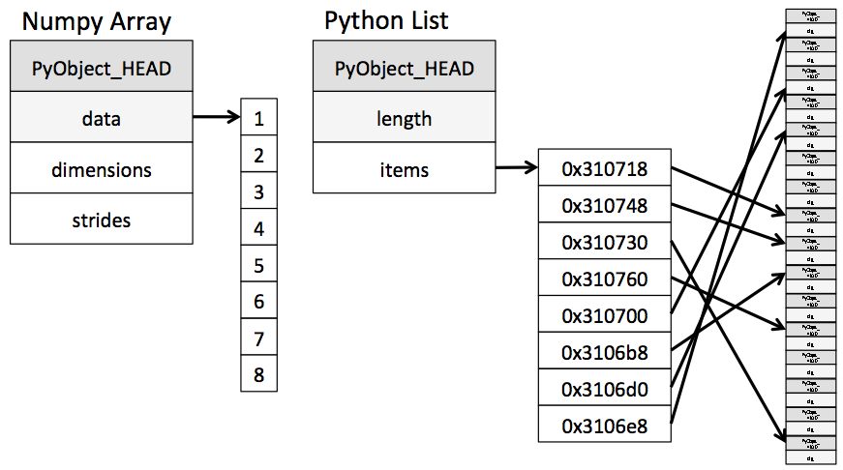
NumPy Arrays
build around a C array with pointers to a contiguous data buffer of values
Linear algebra functions
Fancy indexing
…
>>> import numpy
>>> ary = numpy.array([7, 8, 9, 10, 11])
>>> ary[[2, 4]]
array([ 9, 11])
>>> lst = list([7, 8, 9, 10, 11])
>>> lst[2, 4]]
>>> lst[[2, 4]]
Traceback (most recent call last):
File "<stdin>", line 1, in <module>
TypeError: list indices must be
integers or slices, not list
Image source: “Why Python is Slow: Looking Under the Hood” by Jake VanderPlas
http://jakevdp.github.io/blog/2014/05/09/why-python-is-slow/

Slide 23
SciPy Sparse Matrices
List of Lists (LIL) example
>>> from scipy import sparse
>>> mtx = sparse.lil_matrix([[0, 1, 2, 0],
... [3, 0, 1, 0],
... [1, 0, 0, 1]])
>>> print(mtx)
(0, 1) 1
(0, 2) 2
(1, 0) 3
(1, 2) 1
(2, 0) 1
(2, 3) 1
>>> print(mtx.toarray())
[[0 1 2 0]
[3 0 1 0]
[1 0 0 1]]

Slide 24
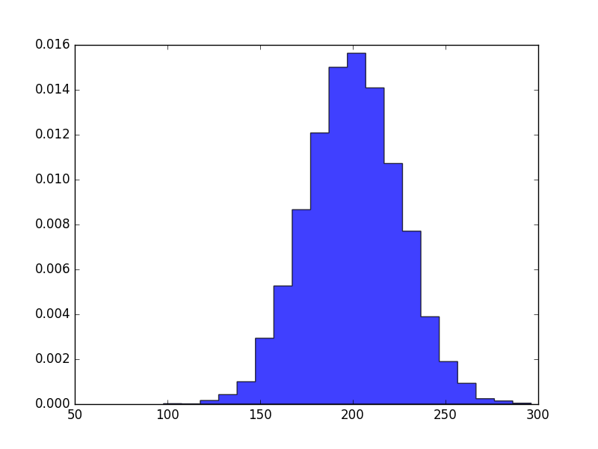
matplotlib
>>> import matplotlib.pyplot as plt
>>> import numpy as np
>>>
>>> mu, sigma = 200, 25
>>> x = mu + sigma*np.random.randn(10000)
>>> plt.hist(x, 20, normed=1,
... histtype='stepfilled',
... facecolor='b',
... alpha=0.75)
>>> plt.show()

Slide 25
Day 1 Session
9:00 AM - 3:00 PM
01 Introduction to machine learning with sample applications
02 Scientific Computing Tools for Python: NumPy, SciPy, and matplotlib
03 Data formats, preparation, and representation
04 Supervised learning: Training and test data
05 Supervised learning: Estimators for classification
06 Supervised learning: Estimators for regression analysis
07 Unsupervised learning: Unsupervised Transformers
08 Unsupervised learning: Clustering
09 The scikit-learn estimator interface
10 Preparing a real-world dataset (titanic)
11 Working with text data via the bag-of-words model
12 Application: SMS spam classification

Slide 26
Iris
Iris-Setosa
Iris-Versicolor
Iris-Setosa

Slide 27
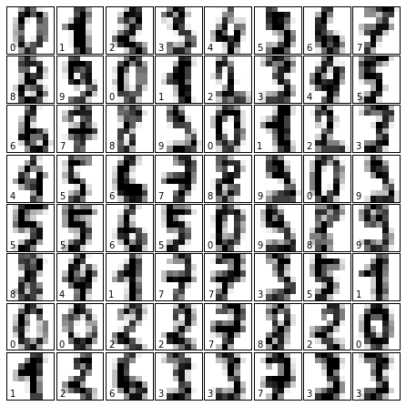
Digits

Slide 28
Generating Synthetic Data
from sklearn.datasets import make_…

Slide 29
Day 1 Session
9:00 AM - 3:00 PM
01 Introduction to machine learning with sample applications
02 Scientific Computing Tools for Python: NumPy, SciPy, and matplotlib
03 Data formats, preparation, and representation
04 Supervised learning: Training and test data
05 Supervised learning: Estimators for classification
06 Supervised learning: Estimators for regression analysis
07 Unsupervised learning: Unsupervised Transformers
08 Unsupervised learning: Clustering
09 The scikit-learn estimator interface
10 Preparing a real-world dataset (titanic)
11 Working with text data via the bag-of-words model
12 Application: SMS spam classification

Slide 30
Training & Test Data
All Data
Training Data
Test Data
Typically:
75% : 25%
2/3 : 1/3

Slide 31
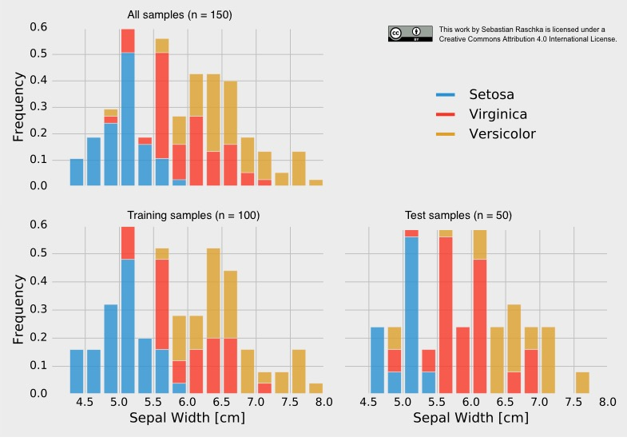
Stratification
Non-stratified split:
training set → 38 x Setosa, 28 x Versicolor, 34 x Virginica
test set → 12 x Setosa, 22 x Versicolor, 16 x Virginica

Slide 32
Day 1 Session
9:00 AM - 3:00 PM
01 Introduction to machine learning with sample applications
02 Scientific Computing Tools for Python: NumPy, SciPy, and matplotlib
03 Data formats, preparation, and representation
04 Supervised learning: Training and test data
05 Supervised learning: Estimators for classification
06 Supervised learning: Estimators for regression analysis
07 Unsupervised learning: Unsupervised Transformers
08 Unsupervised learning: Clustering
09 The scikit-learn estimator interface
10 Preparing a real-world dataset (titanic)
11 Working with text data via the bag-of-words model
12 Application: SMS spam classification

Slide 33
Supervised Workflow
TRAINING
GENERALIZATION
Fit model on all data after evaluation

Slide 34
Supervised Workflow
estimator.fit(X_train, y_train)
TRAINING
estimator.predict(X_test)
GENERALIZATION
estimator.score(X_test, y_test)

Slide 35
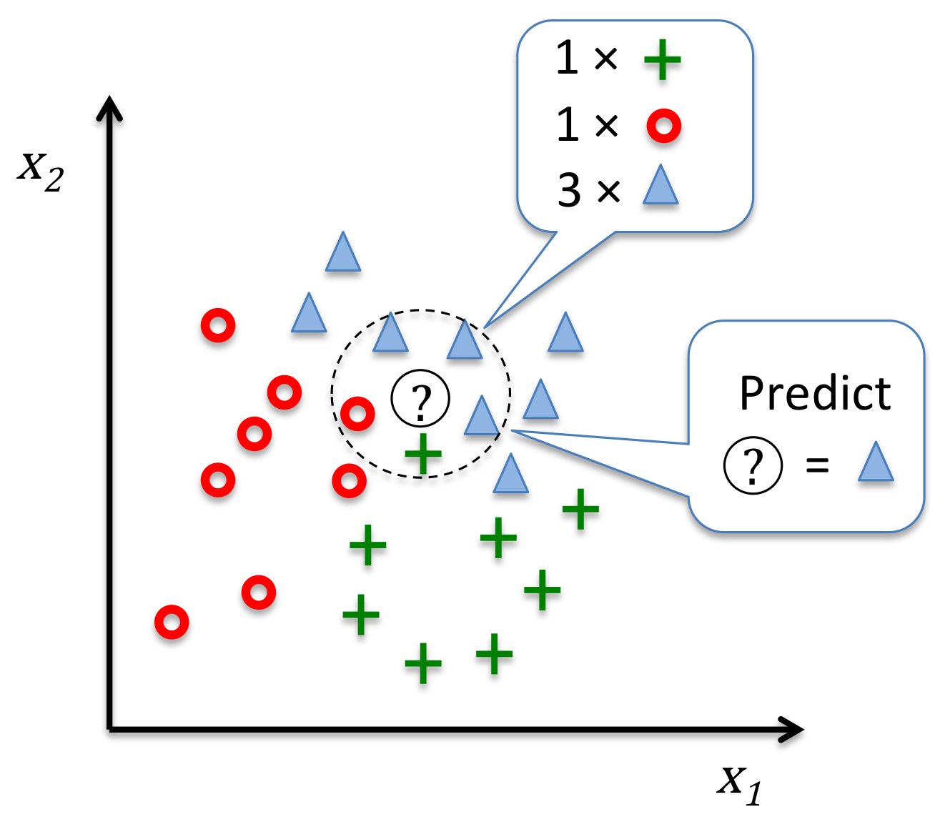
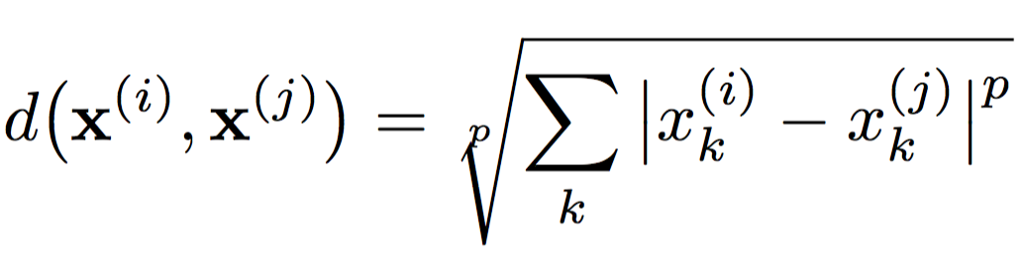
K-Nearest Neighbors
k=5
Image source: https://github.com/rasbt/python-machine-learning-book/blob/master/code/ch03/images/03_20.png

Slide 36
Day 1 Session
9:00 AM - 3:00 PM
01 Introduction to machine learning with sample applications
02 Scientific Computing Tools for Python: NumPy, SciPy, and matplotlib
03 Data formats, preparation, and representation
04 Supervised learning: Training and test data
05 Supervised learning: Estimators for classification
06 Supervised learning: Estimators for regression analysis
07 Unsupervised learning: Unsupervised Transformers
08 Unsupervised learning: Clustering
09 The scikit-learn estimator interface
10 Preparing a real-world dataset (titanic)
11 Working with text data via the bag-of-words model
12 Application: SMS spam classification

Slide 37
Linear Regression
y =coef_[0]*X[0] + intercept_
y (target variable)
X[0] (feature variable)

Slide 38
Day 1 Session
9:00 AM - 3:00 PM
01 Introduction to machine learning with sample applications
02 Scientific Computing Tools for Python: NumPy, SciPy, and matplotlib
03 Data formats, preparation, and representation
04 Supervised learning: Training and test data
05 Supervised learning: Estimators for classification
06 Supervised learning: Estimators for regression analysis
07 Unsupervised learning: Unsupervised Transformers
08 Unsupervised learning: Clustering
09 The scikit-learn estimator interface
10 Preparing a real-world dataset (titanic)
11 Working with text data via the bag-of-words model
12 Application: SMS spam classification

Slide 39
Unsupervised Transformers
transformer.fit(X_train)
X_train_transf = transformer.transform(X_train)
X_test_transf = transformer.transform(X_test)

Slide 40
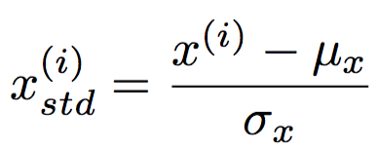
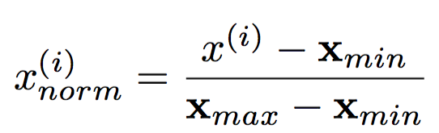
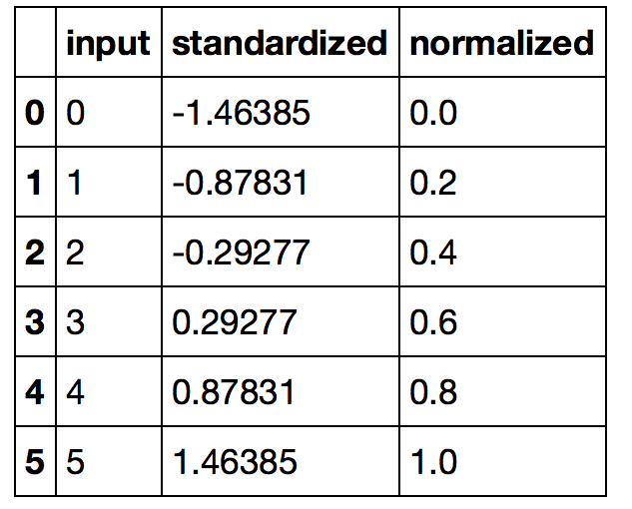
Feature Scaling
standardization
min-max scaling

Slide 41
Principal Component Analysis
PC1
PC2
x₂
x₁

Slide 42
PCA for Dimensionality Reduction

Slide 43
Day 1 Session
9:00 AM - 3:00 PM
01 Introduction to machine learning with sample applications
02 Scientific Computing Tools for Python: NumPy, SciPy, and matplotlib
03 Data formats, preparation, and representation
04 Supervised learning: Training and test data
05 Supervised learning: Estimators for classification
06 Supervised learning: Estimators for regression analysis
07 Unsupervised learning: Unsupervised Transformers
08 Unsupervised learning: Clustering
09 The scikit-learn estimator interface
10 Preparing a real-world dataset (titanic)
11 Working with text data via the bag-of-words model
12 Application: SMS spam classification

Slide 44
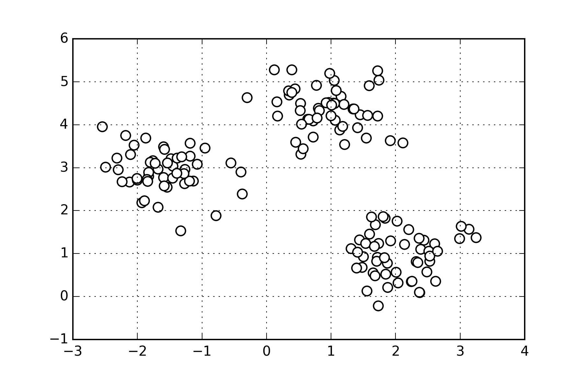
K-means Clustering

Slide 45
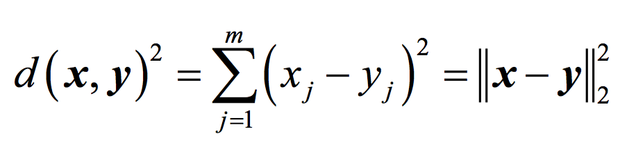
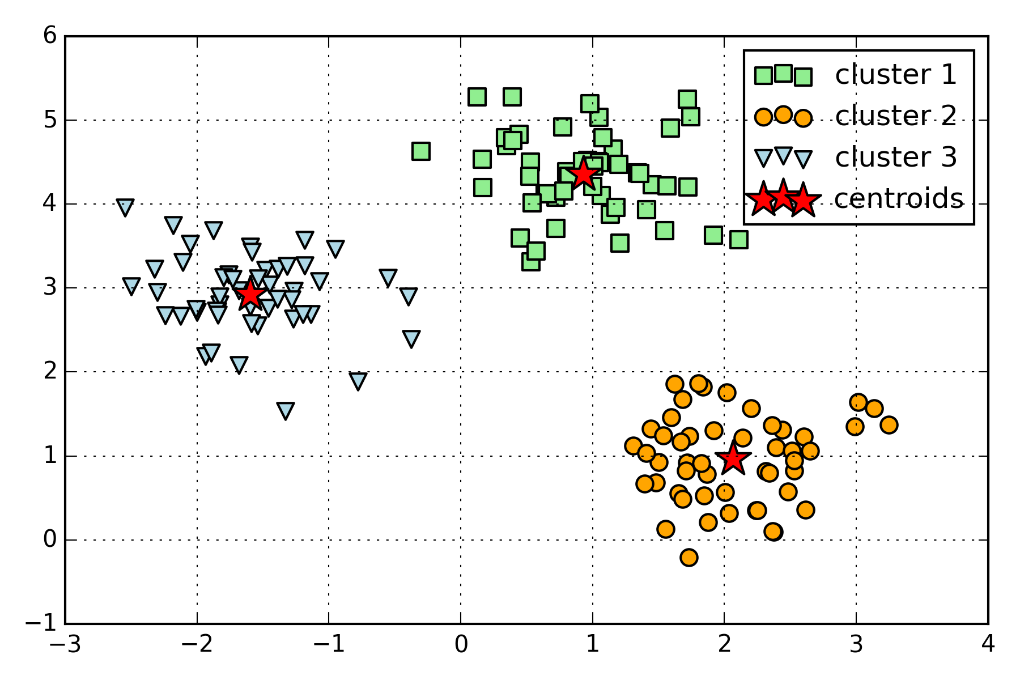
K-means Clustering

Slide 46
Day 1 Session
9:00 AM - 3:00 PM
01 Introduction to machine learning with sample applications
02 Scientific Computing Tools for Python: NumPy, SciPy, and matplotlib
03 Data formats, preparation, and representation
04 Supervised learning: Training and test data
05 Supervised learning: Estimators for classification
06 Supervised learning: Estimators for regression analysis
07 Unsupervised learning: Unsupervised Transformers
08 Unsupervised learning: Clustering
09 The scikit-learn estimator interface
10 Preparing a real-world dataset (titanic)
11 Working with text data via the bag-of-words model
12 Application: SMS spam classification

Slide 47
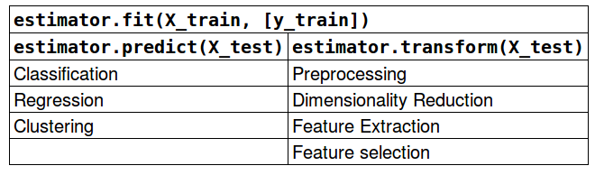
Scikit-learn API

Slide 48
Day 1 Session
9:00 AM - 3:00 PM
01 Introduction to machine learning with sample applications
02 Scientific Computing Tools for Python: NumPy, SciPy, and matplotlib
03 Data formats, preparation, and representation
04 Supervised learning: Training and test data
05 Supervised learning: Estimators for classification
06 Supervised learning: Estimators for regression analysis
07 Unsupervised learning: Unsupervised Transformers
08 Unsupervised learning: Clustering
09 The scikit-learn estimator interface
10 Preparing a real-world dataset (titanic)
11 Working with text data via the bag-of-words model
12 Application: SMS spam classification

Slide 49
Continuous & Categorical Features
Continuous
Categorical
e.g., sepal width in cm
[3.4, 4.7 …]
Nominal
Ordinal
e.g., colors
[red, green, blue, …]
e.g., ratings
[satisfied, neutral, unsatisfied]

Slide 50
Case Study - Titanic Survival

Slide 51
Day 1 Session
9:00 AM - 3:00 PM
01 Introduction to machine learning with sample applications
02 Scientific Computing Tools for Python: NumPy, SciPy, and matplotlib
03 Data formats, preparation, and representation
04 Supervised learning: Training and test data
05 Supervised learning: Estimators for classification
06 Supervised learning: Estimators for regression analysis
07 Unsupervised learning: Unsupervised Transformers
08 Unsupervised learning: Clustering
09 The scikit-learn estimator interface
10 Preparing a real-world dataset (titanic)
11 Working with text data via the bag-of-words model
12 Application: SMS spam classification

Slide 52
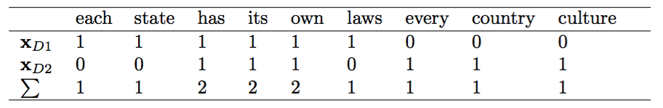
Bag of Words
• D1: ”Each state has its own laws.” • D2: ”Every country has its own culture.”
V ={each:1, state:1, has:2, its:2, own:2,
laws: 1, every: 1, country: 1, culture: 1}

Slide 53
Day 1 Session
9:00 AM - 3:00 PM
01 Introduction to machine learning with sample applications
02 Scientific Computing Tools for Python: NumPy, SciPy, and matplotlib
03 Data formats, preparation, and representation
04 Supervised learning: Training and test data
05 Supervised learning: Estimators for classification
06 Supervised learning: Estimators for regression analysis
07 Unsupervised learning: Unsupervised Transformers
08 Unsupervised learning: Clustering
09 The scikit-learn estimator interface
10 Preparing a real-world dataset (titanic)
11 Working with text data via the bag-of-words model
12 Application: SMS spam classification

Slide 54
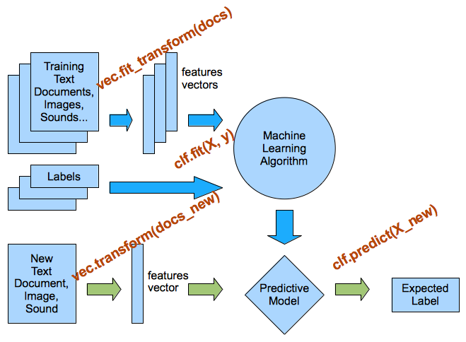
Preprocessing & Classification Overview

Slide 55
Day 2 Session
9:00 AM - 3:00 PM
13 Cross-Validation
14 Model complexity and grid search for adjusting hyperparameters
15 Scikit-learn Pipelines
16 Supervised learning: Performance metrics for classification
17 Supervised learning: Linear Models
18 Supervised learning: Support Vector Machines
19 Supervised learning: Decision trees and random forests, ensemble methods
20 Supervised learning: Feature selection
21 Unsupervised learning: Hierarchical and density-based clustering algorithms
22 Unsupervised learning: Non-linear dimensionality reduction
23 Automated machine learning

Slide 56
Holdout Evaluation I

Slide 57
Holdout Evaluation II

Slide 58
Holdout Validation I

Slide 59
Holdout Validation II

Slide 60
Holdout Validation III

Slide 61
K-fold Cross-Validation
5
5

Slide 62
K-fold Cross-Validation Pipeline I

Slide 63
K-fold Cross-Validation Pipeline II

Slide 64
Day 2 Session
9:00 AM - 3:00 PM
13 Cross-Validation
14 Model complexity and grid search for adjusting hyperparameters
15 Scikit-learn Pipelines
16 Supervised learning: Performance metrics for classification
17 Supervised learning: Linear Models
18 Supervised learning: Support Vector Machines
19 Supervised learning: Decision trees and random forests, ensemble methods
20 Supervised learning: Feature selection
21 Unsupervised learning: Hierarchical and density-based clustering algorithms
22 Unsupervised learning: Non-linear dimensionality reduction
23 Automated machine learning

Slide 65
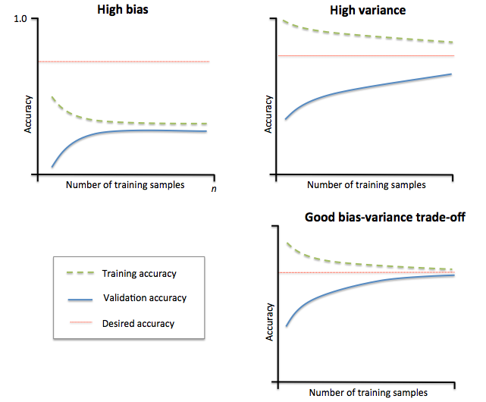
Learning Curves
Image source: https://github.com/rasbt/python-machine-learning-book/blob/master/code/ch06/images/06_04.png

Slide 66
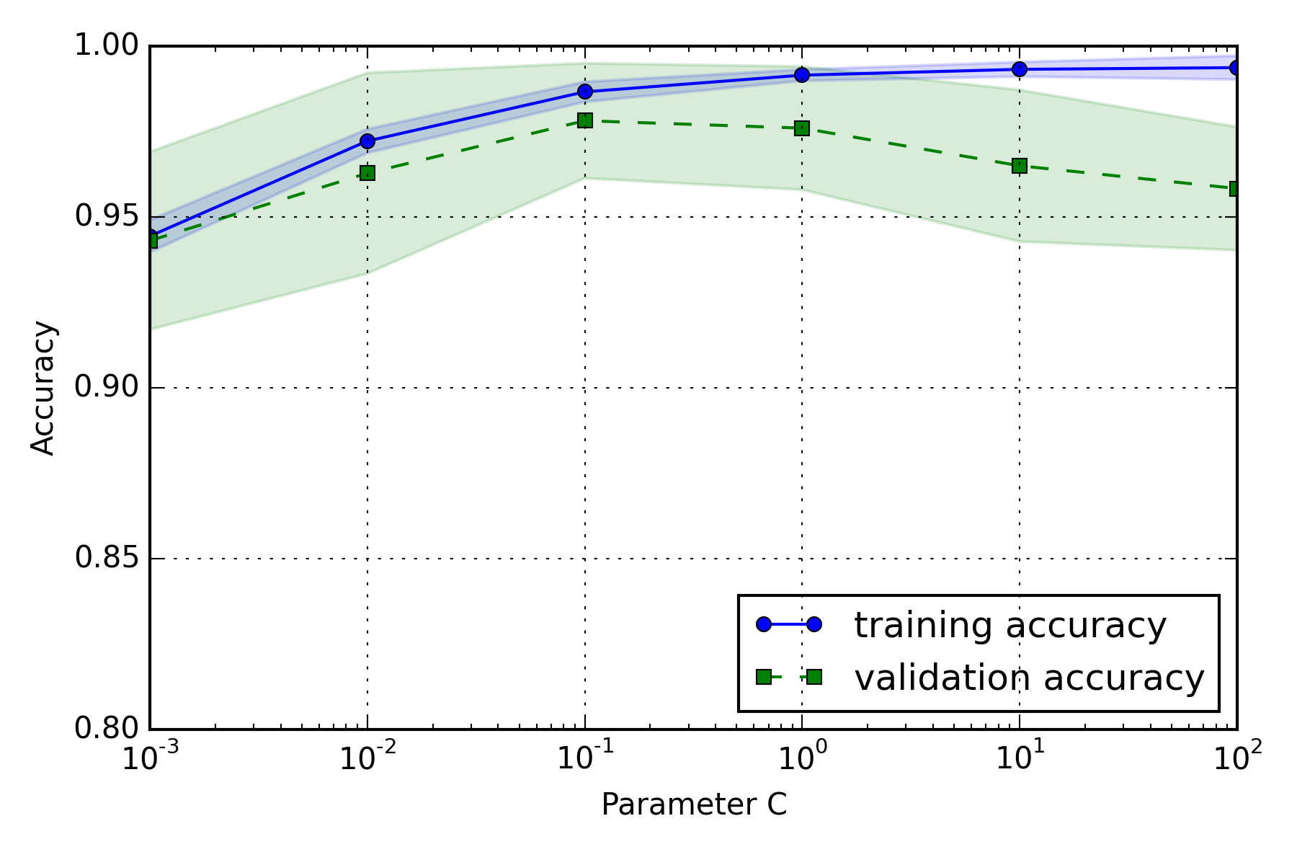
Model Complexity

Slide 67
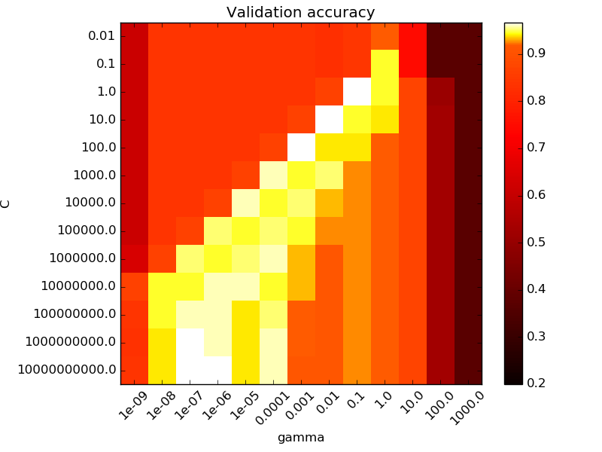
Grid Search
C parameter
gamma parameter
Source: http://scikit-learn.org/stable/auto_examples/svm/plot_rbf_parameters.html

Slide 68
Day 2 Session
9:00 AM - 3:00 PM
13 Cross-Validation
14 Model complexity and grid search for adjusting hyperparameters
15 Scikit-learn Pipelines
16 Supervised learning: Performance metrics for classification
17 Supervised learning: Linear Models
18 Supervised learning: Support Vector Machines
19 Supervised learning: Decision trees and random forests, ensemble methods
20 Supervised learning: Feature selection
21 Unsupervised learning: Hierarchical and density-based clustering algorithms
22 Unsupervised learning: Non-linear dimensionality reduction
23 Automated machine learning

Slide 69
Pipelines

Slide 70
Pipelines & Cross Validation

Slide 71
Day 2 Session
9:00 AM - 3:00 PM
13 Cross-Validation
14 Model complexity and grid search for adjusting hyperparameters
15 Scikit-learn Pipelines
16 Supervised learning: Performance metrics for classification
17 Supervised learning: Linear Models
18 Supervised learning: Support Vector Machines
19 Supervised learning: Decision trees and random forests, ensemble methods
20 Supervised learning: Feature selection
21 Unsupervised learning: Hierarchical and density-based clustering algorithms
22 Unsupervised learning: Non-linear dimensionality reduction
23 Automated machine learning

Slide 72
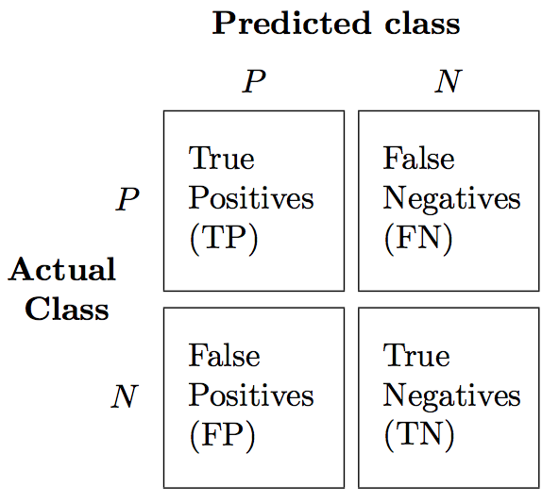
Confusion Matrix

Slide 73
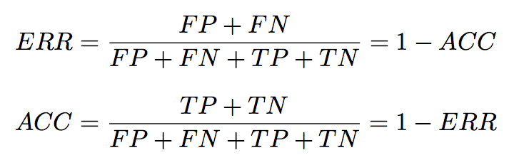
Classification Metrics I

Slide 74
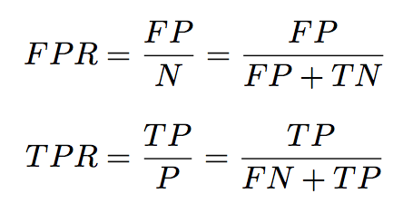
Classification Metrics II

Slide 75
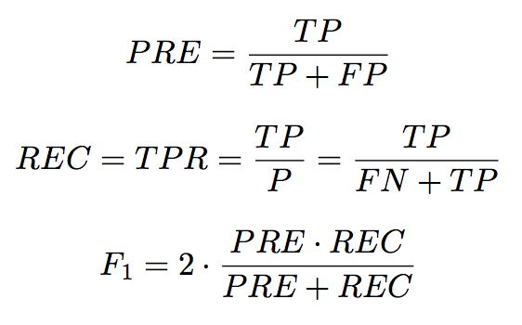
Classification Metrics III

Slide 76
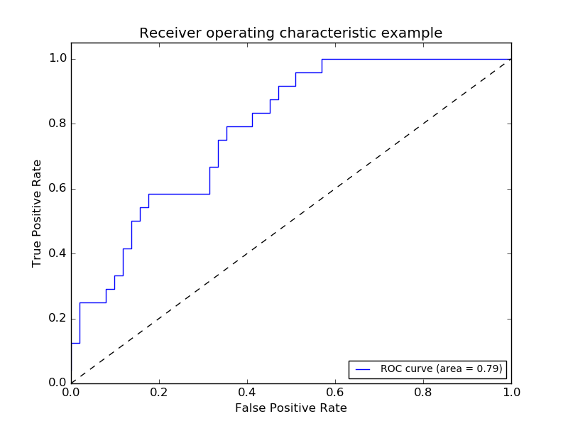
Receiver Operator Characteristic
Image source: http://scikit-learn.org/stable/_images/plot_roc_001.png

Slide 77
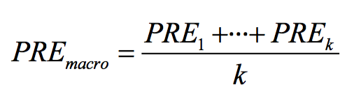
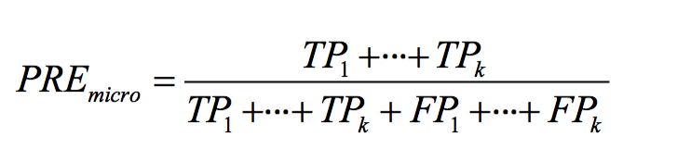
Multi-Class

Slide 78
Day 2 Session
9:00 AM - 3:00 PM
13 Cross-Validation
14 Model complexity and grid search for adjusting hyperparameters
15 Scikit-learn Pipelines
16 Supervised learning: Performance metrics for classification
17 Supervised learning: Linear Models
18 Supervised learning: Support Vector Machines
19 Supervised learning: Decision trees and random forests, ensemble methods
20 Supervised learning: Feature selection
21 Unsupervised learning: Hierarchical and density-based clustering algorithms
22 Unsupervised learning: Non-linear dimensionality reduction
23 Automated machine learning

Slide 79
Linear models for regression
y_pred = x_test[0] * coef_[0] + ...
+ x_test[n_features-1] * coef_[n_features-1]
+ intercept_
y
slope (=Δy/Δx)
x[0]

Slide 80
Day 2 Session
9:00 AM - 3:00 PM
13 Cross-Validation
14 Model complexity and grid search for adjusting hyperparameters
15 Scikit-learn Pipelines
16 Supervised learning: Performance metrics for classification
17 Supervised learning: Linear Models
18 Supervised learning: Support Vector Machines
19 Supervised learning: Decision trees and random forests, ensemble methods
20 Supervised learning: Feature selection
21 Unsupervised learning: Hierarchical and density-based clustering algorithms
22 Unsupervised learning: Non-linear dimensionality reduction
23 Automated machine learning
A

Slide 81
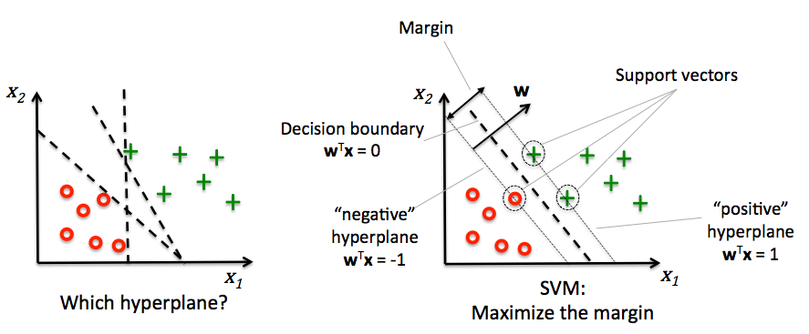
Support Vector Machines
Image source: https://github.com/rasbt/python-machine-learning-book/blob/master/code/ch03/images/03_07.png

Slide 82
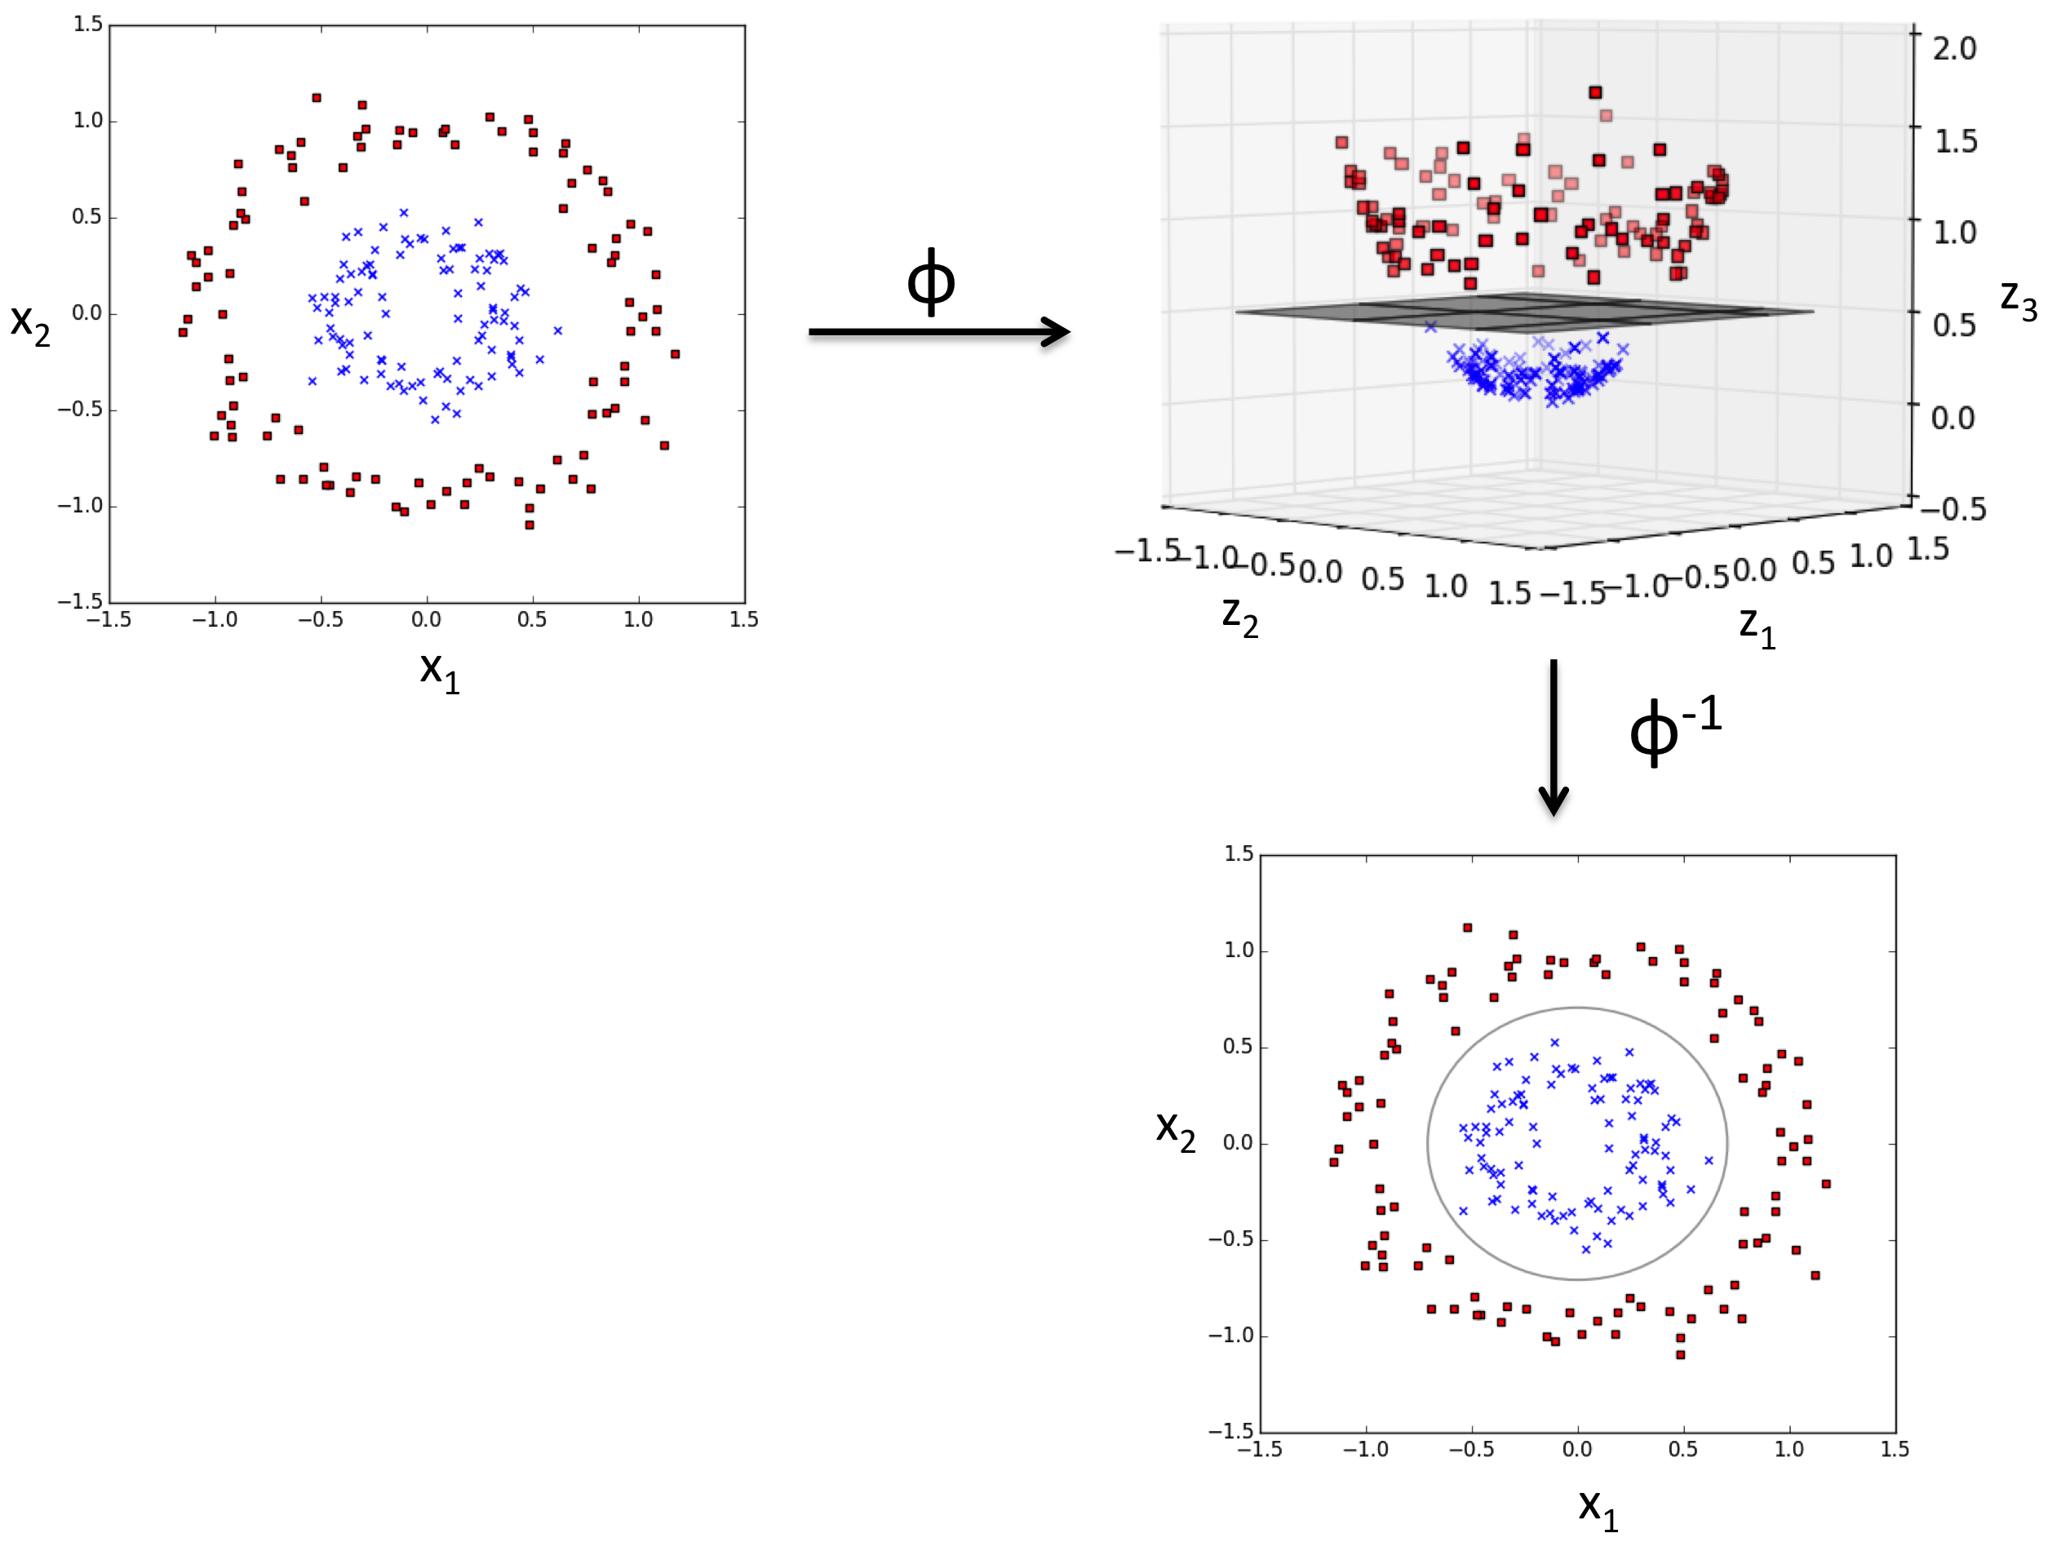
Kernel Method & Kernel Trick
https://github.com/rasbt/python-machine-learning-book/blob/master/code/ch03/images/03_11.png
Notes:
Kernels: project the data into an “infinite” dimensional space, draw a linear separating line, then map the line back down to the original dimensions.
Kernel trick: Fancy math allows us to accomplish the “infinite” dimensional mapping to calculate distances between points without actually mapping them into that space.

Slide 83
Day 2 Session
9:00 AM - 3:00 PM
13 Cross-Validation
14 Model complexity and grid search for adjusting hyperparameters
15 Scikit-learn Pipelines
16 Supervised learning: Performance metrics for classification
17 Supervised learning: Linear Models
18 Supervised learning: Support Vector Machines
19 Supervised learning: Decision trees and random forests, ensemble methods
20 Supervised learning: Feature selection
21 Unsupervised learning: Hierarchical and density-based clustering algorithms
22 Unsupervised learning: Non-linear dimensionality reduction
23 Automated machine learning

Slide 84
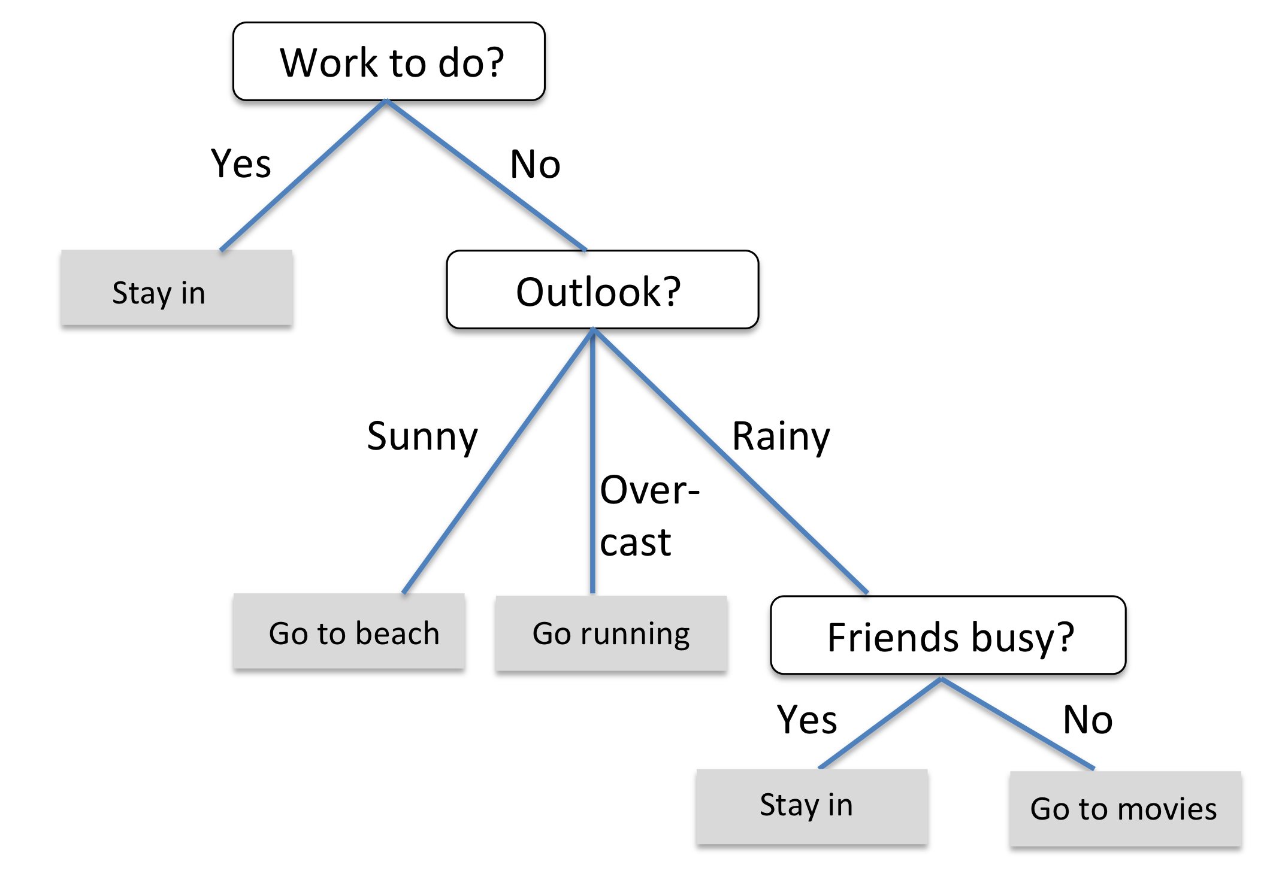
Decision Trees

Slide 85
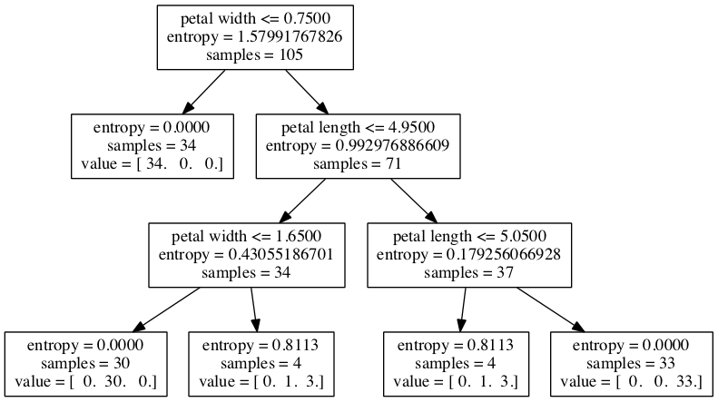
Classification w. Continuous Features

Slide 86
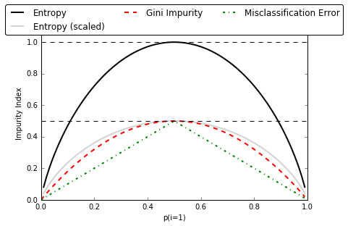
Impurity measures

Slide 87
Ensemble Methods
Bagging
Boosting
Random
Forests

Slide 88
Day 2 Session
9:00 AM - 3:00 PM
13 Cross-Validation
14 Model complexity and grid search for adjusting hyperparameters
15 Scikit-learn Pipelines
16 Supervised learning: Performance metrics for classification
17 Supervised learning: Linear Models
18 Supervised learning: Support Vector Machines
19 Supervised learning: Decision trees and random forests, ensemble methods
20 Supervised learning: Feature selection
21 Unsupervised learning: Hierarchical and density-based clustering algorithms
22 Unsupervised learning: Non-linear dimensionality reduction
23 Automated machine learning

Slide 89
Dimensionality Reduction
Dimensionality Reduction
Feature Selection
Feature Extraction

Slide 90
Day 2 Session
9:00 AM - 3:00 PM
13 Cross-Validation
14 Model complexity and grid search for adjusting hyperparameters
15 Scikit-learn Pipelines
16 Supervised learning: Performance metrics for classification
17 Supervised learning: Linear Models
18 Supervised learning: Support Vector Machines
19 Supervised learning: Decision trees and random forests, ensemble methods
20 Supervised learning: Feature selection
21 Unsupervised learning: Hierarchical and density-based clustering algorithms
22 Unsupervised learning: Non-linear dimensionality reduction
23 Automated machine learning

Slide 91
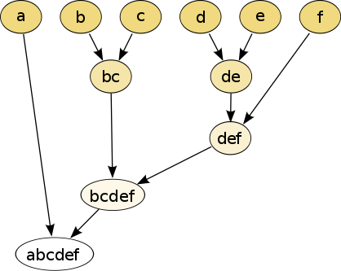
Hierarchical Clustering
https://en.wikipedia.org/wiki/Hierarchical_clustering#/media/File:Hierarchical_clustering_simple_diagram.svg [CC BY-SA 3.0]

Slide 92
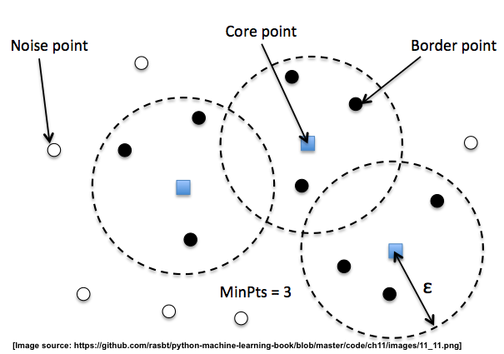
DBSCAN

Slide 93
Day 2 Session
9:00 AM - 3:00 PM
13 Cross-Validation
14 Model complexity and grid search for adjusting hyperparameters
15 Scikit-learn Pipelines
16 Supervised learning: Performance metrics for classification
17 Supervised learning: Linear Models
18 Supervised learning: Support Vector Machines
19 Supervised learning: Decision trees and random forests, ensemble methods
20 Supervised learning: Feature selection
21 Unsupervised learning: Hierarchical and density-based clustering algorithms
22 Unsupervised learning: Non-linear dimensionality reduction
23 Automated machine learning

Slide 94
PCA
2D
1D
?

Slide 95
PCA
2D
1D

Slide 96
Kernel PCA
2D
1D

Slide 97
Day 2 Session
9:00 AM - 3:00 PM
13 Cross-Validation
14 Model complexity and grid search for adjusting hyperparameters
15 Scikit-learn Pipelines
16 Supervised learning: Performance metrics for classification
17 Supervised learning: Linear Models
18 Supervised learning: Support Vector Machines
19 Supervised learning: Decision trees and random forests, ensemble methods
20 Supervised learning: Feature selection
21 Unsupervised learning: Hierarchical and density-based clustering algorithms
22 Unsupervised learning: Non-linear dimensionality reduction
23 Automated machine learning

Slide 98

scikit-learn.org/stable/tutorial/machine_learning_map/index.html

Slide 99
What to do next?
Practice
Kaggle.com
UCI Machine Learning repository
Learn advanced ML methods
XGBoost
Deep Learning

Slide 100
What to do next?
Read

Slide 101
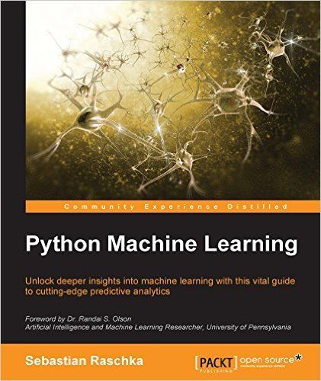
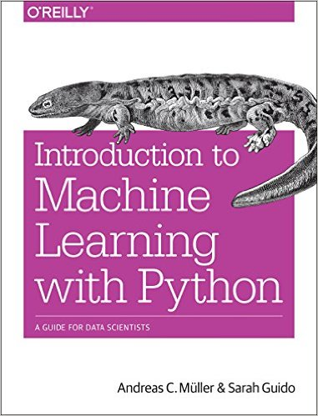
Recommended Books I

Slide 102
Recommended Books II
DeepLearningBook.org

Slide 103
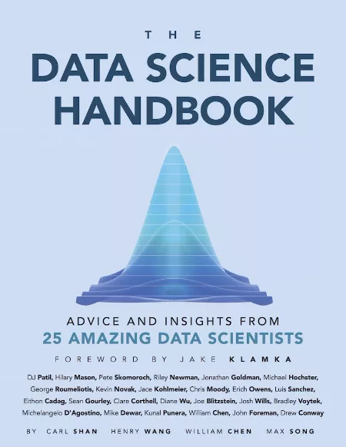
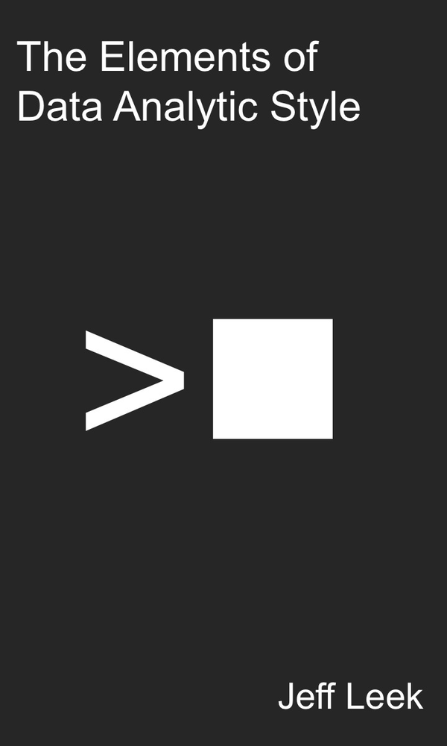
Recommended Books III

Slide 104
What to do next?
Read
Take online courses

Slide 105
Recommended Courses
Machine Learning (Coursera)
coursera.org/learn/machine-learning
Deep Learning (Udacity)
udacity.com/course/deep-learning--ud730

Slide 106
What to do next?
Contribute
github.com/scikit-learn/scikit-learn
scikit-learn.org/stable/related_projects.html

